Slide 1
Lecture 27: LM3S9B96 Microcontroller – Inter-Integrated Circuit (I²C) Interface

Slide 2
Stellaris® LM3S9B96 Microcontroller
Data Sheet
Chapter 16
Inter-Integrated Circuit (I²C) Interface

Slide 3
Inter-Integrated Circuit (I²C) Interface
The Inter-Integrated Circuit (I²C) bus :
bi-directional data transfer via a two-wire design: a serial data line SDA and a serial clock line SCL
interfaces to external I²C devices: serial memory, networking devices, LCDs, tone generators

Slide 4
Inter-Integrated Circuit (I²C) Interface
The LM3S9B96 microcontroller includes two I²C modules:
Supports both transmitting and receiving data as either a master or a slave
Four I²C modes: Master/Slave transmit/receive
Two transmission speeds: Standard (100 Kbps) and Fast (400 Kbps)
Master and slave interrupt generation
Master with arbitration and clock synchronization, multi-master support, and 7-bit addressing mode

Slide 5
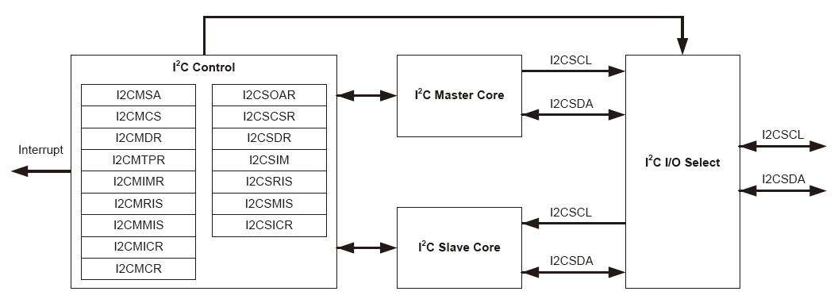
Block Diagram

Slide 6
Functional Description
The I²C bus uses only two signals: SDA and SCL, named I2CSDA and I2CSCL on Stellaris microcontrollers
The bus is considered idle when both lines are High
Every transaction on the I2C bus is nine bits long, i.e., 8 data bits (MSB first) and 1 single acknowledge bit
The number of bytes in one transfer is unrestricted
When a receiver cannot receive another complete byte, it can hold the clock line SCL Low and force the transmitter into a wait state
The data transfer continues when the receiver releases the clock SCL

Slide 7
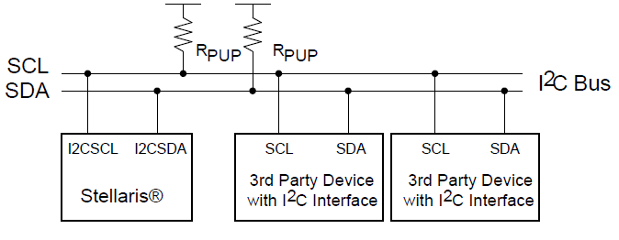
I²C Bus Configuration

Slide 8
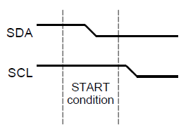
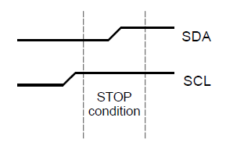
START and STOP Conditions
The protocol of the I²C bus defines two states to begin and end a transaction: START and STOP
A High-to-Low transition on the SDA line while the SCL is High is defined as a START condition
A Low-to-High transition on the SDA line while SCL is High is defined as a STOP condition

Slide 9
Data Format with 7-Bit Address
After the START condition, a slave address is transmitted
The address is 7 bits long and followed by a direction bit (R/S bit in the I2C Master Slave Address (I2CMSA) register)
R/S is cleared, a transmit operation (send)
R/S is set, a request for data (receive)
A data transfer is always terminated by a STOP condition generated by the master
A master can initiate communications with another device on the bus by generating a repeated START condition and addressing another slave without first generating a STOP condition.

Slide 10
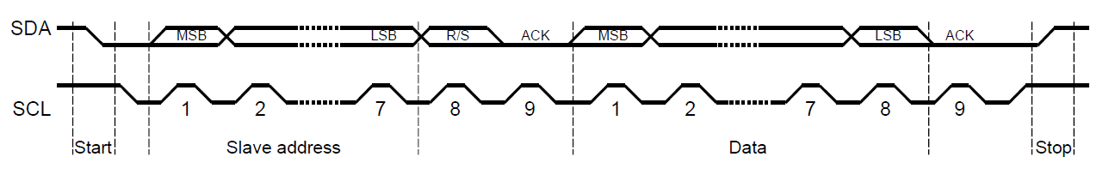
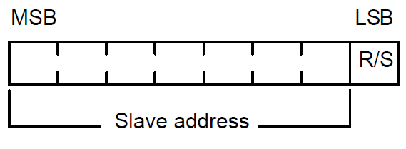
Data Format with 7-Bit Address
A zero in the R/S position of the first byte means that the master transmits (sends) data to the selected slave, and a one in this position means that the master receives data from the slave

Slide 11
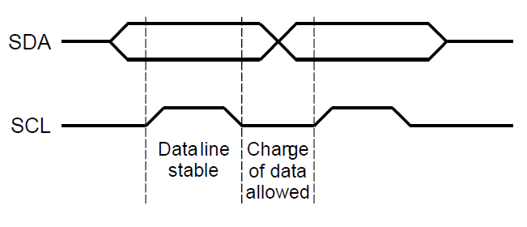
Data Validity
The data on the SDA line must be stable during the high period of the clock
The data line can only change when SCL is Low

Slide 12
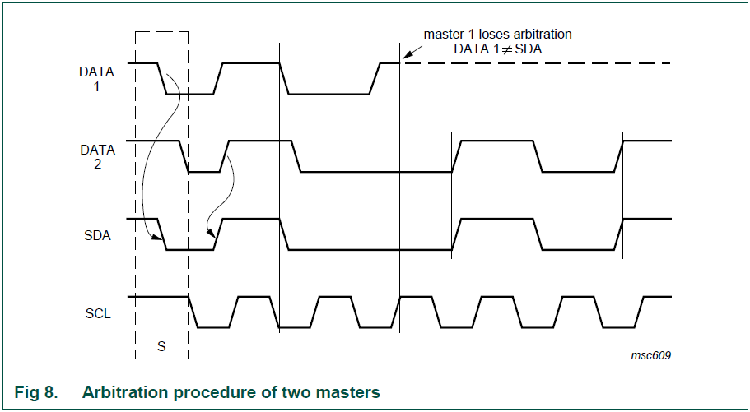
Arbitration

Slide 13
Acknowledge
All bus transactions have a required acknowledge clock cycle
During the acknowledge cycle, the transmitter (master or slave) releases the SDA line
To acknowledge the transaction, the receiver must pull down SDA during the acknowledge clock cycle
When a slave receiver does not ack the slave address, the master can generate a STOP condition and abort the current transfer.
When the master acting as a receiver, it is responsible for acknowledging each transfer made by the slave
The master receiver controls the number of bytes in the transfer by not generating an acknowledge on the last data byte; slave transmitter will give up the data line

Slide 14
Available Speed Modes
The I²C bus can run in either Standard mode (100 kbps) or Fast mode (400 kbps)
The selected mode should match the speed of the other I²C devices on the bus
The mode is selected by using a value in the I2C Master Timer Period (I2CMTPR) register
The I2C clock rate is determined by the parameters:
CLK_PRD is the system clock period
SCL_LP is the low phase of SCL (fixed at 6)
SCL_HP is the high phase of SCL (fixed at 4)
TIMER_PRD is the programmed value in the I2CMTPR register

Slide 15
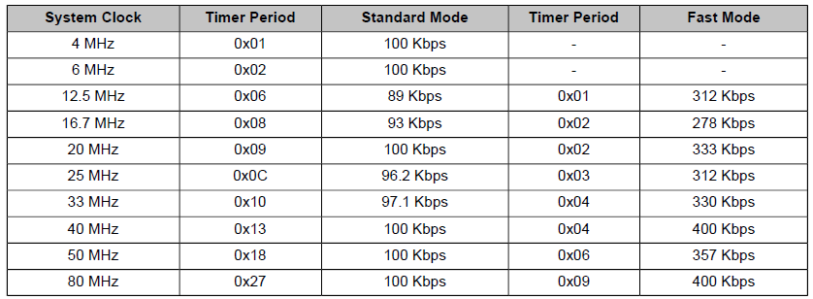
Available Speed Modes
SCL_PERIOD = 2 × (1 + TIMER_PRD) × (SCL_LP + SCL_HP) × CLK_PRD
For example: CLK_PRD = 50 ns, TIMER_PRD = 2, SCL_LP=6, SCL_HP=4
Therefore, the SCL frequency is : 1/SCL_PERIOD = 333 Khz

Slide 16
Interrupts
The I2C can generate interrupts when the following conditions are observed:
Master transaction completed
Master transaction error
Slave transaction received
Slave transaction requested
Stop condition on bus detected
Start condition on bus detected
The I2C master and I2C slave modules have separate interrupt signals
A module can generate interrupts for multiple conditions but only one single interrupt signal is sent to the interrupt controller

Slide 17
I²C Master Interrupts
When a transaction completes or when an error occurs during a transaction
To enable the I²C master interrupt, the IM bit in the I2C Master Interrupt Mask (I2CMIMR) register must be set
When an interrupt condition is met, software must check the ERROR bit in the I2C Master Control/Status (I2CMCS) register to verify that an error didn't occur
The interrupt is cleared by writing a 1 to the IC bit in the I2C Master Interrupt Clear (I2CMICR) register
If the application doesn't require the use of interrupts, the raw interrupt status is always visible via the I2C Master Raw Interrupt Status (I2CMRIS) register

Slide 18
I²C Slave Interrupts
When data has been received or requested
This interrupt is enabled by setting the DATAIM bit in the in the I2C Slave Interrupt Mask (I2CSIMR) register
Software determines whether the module should write (transmit) or read (receive) data from the I2C Slave Data (I2CSDR) register, by checking the RREQ and TREQ bits of the I2C Slave Control/Status (I2CSCSR) register
The interrupt is cleared by setting the DATAIC bit in the I2C Slave Interrupt Clear (I2CSICR) register
In addition, the slave module can generate an interrupt when a start and stop condition is detected (STARTIM and STOPIM bits in I2CSIMR)
If the application doesn't require the use of interrupts, the raw interrupt status is always visible via the I2C Slave Raw Interrupt Status (I2CMRIS) register

Slide 19
Loopback Operation
The I²C modules can be placed into an internal loopback mode for diagnostic or debug work
Set the LPBK bit in the I2C Master Configuration (I2CMCR) register
SDA and SCL signals from the master and slave modules are tied together

Slide 20
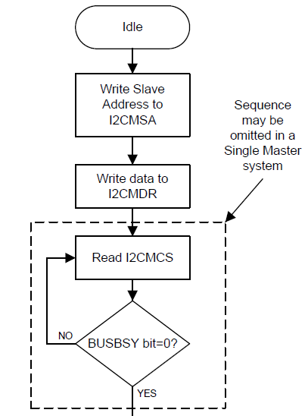
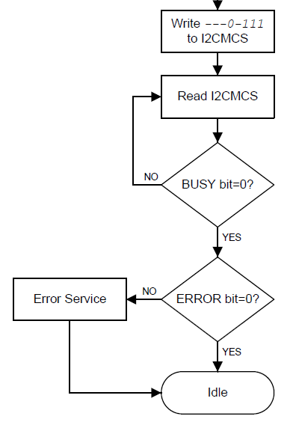
I²C Master Command Sequences

Slide 21
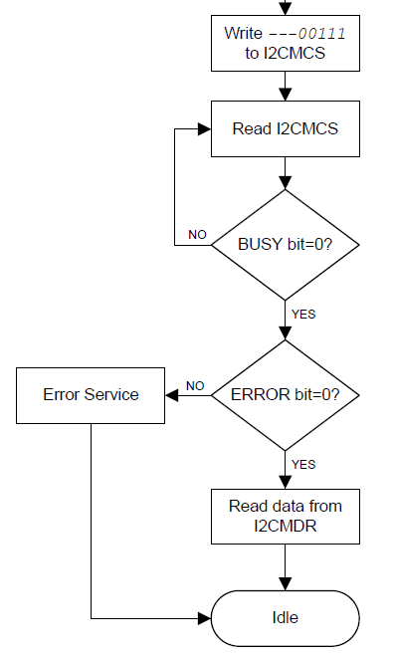
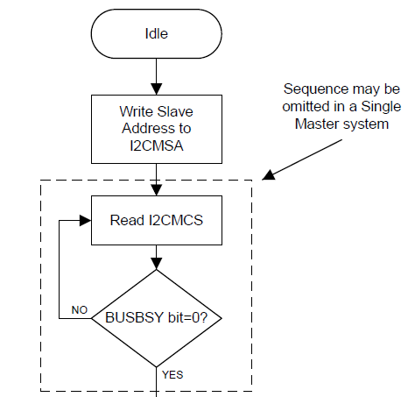
I²C Master Command Sequences

Slide 22
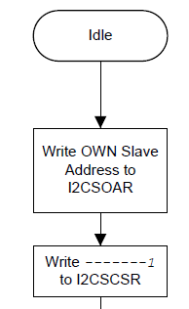
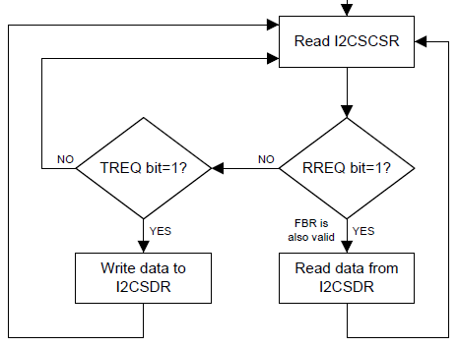
I²C Slave Command Sequences

Slide 23
Initialization and Configuration
The following example shows how to configure the I²C module to transmit a single byte as a master:
1. Enable the I²C clock by writing a value of 0x00001000 to the RCGC1 register in the System Control module
2. Enable the clock to the appropriate GPIO module via the RCGC2 register in the System Control module
3. In the GPIO module, enable the appropriate pins for their alternate function using the GPIOAFSEL register
4. Enable the I²C pins for Open Drain operation
5. Configure the PMCn fields in the GPIOPCTL register to assign the I2C signals to the appropriate
6. Initialize the I2C Master by writing the I2CMCR register with a value of 0x00000010

Slide 24
Initialization and Configuration
7. Set the desired SCL clock speed of 100 Kbps by writing the I2CMTPR register with the correct value:
(System Clock/(2*(SCL_LP + SCL_HP)*SCL_CLK))-1;
= (20MHz/(2*(6+4)*100000))-1;
= 9
8. Specify the slave address of the master and that the next operation is a Transmit by writing the I2CMSA register with a value of 0x00000076, which sets the slave address to 0x3B
9. Place data (byte) to be transmitted in the data register by writing the I2CMDR register with the desired data
10. Initiate a single byte transmit of the data from Master to Slave by writing the I2CMCS register with a value of 0x00000007 (STOP, START, RUN)
11. Wait until the transmission completes by polling the I2CMCS register’s BUSBSY bit until it has been cleared.

Slide 25
Register Map
The I²C’s base address:
I²C Master 0: 0x4002.0000
I²C Slave 0: 0x4002.0800
I²C Master 1: 0x4002.1000
I²C Slave 1: 0x4002.1800
Table 16-4 on page 701 lists the I²C interface registers.
For detailed register descriptions, refer to Chapter 16.6

